Slide 1
Distributed Control and Automation Framework (DCAF)
Designing an Application with DCAF
Benjamin Celis, Mathew Pollock, Simon Perez

Slide 2
Agenda
What should be a module?
How many Modules do I need?
Interacting with code outside the engine

Slide 3
What should be a Module?

Slide 4
What Should be a Module
Modules should operate on latest value (Tag) data
They should generate new values, modify existing values, or route values
Communicating stream data between modules may not be a good fit

Slide 5
What Should be a Module
Application Specific vs Reusable
Application Logic could be within a module or outside of DCAF
Consider making a module into a state machine for control
Remember the state machine should not block
Do not hold state data in the module unless there can be only one instance

Slide 6
Interacting with code Outside the Engine
CVT

Slide 7
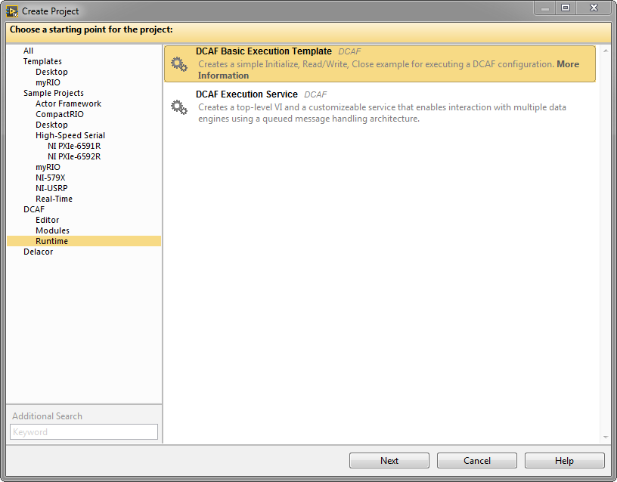
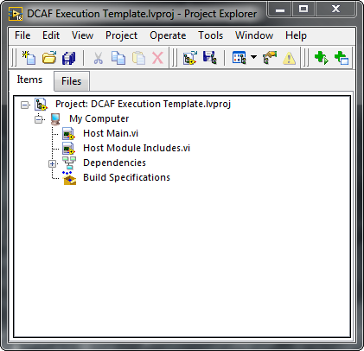
DCAF Project Templates
Notes:
Application templates exist in addition to the plugin templates.

Slide 8
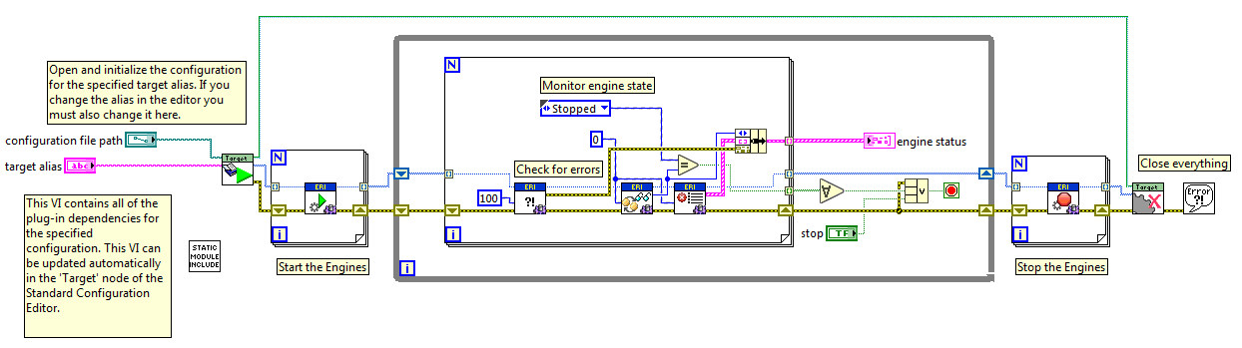
Running the Configuration

Slide 9
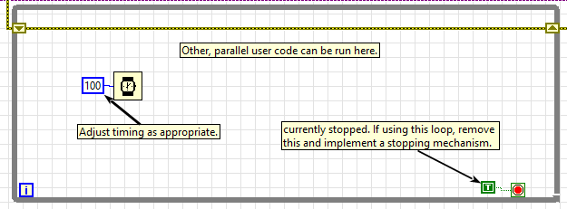
Coding outside DCAF
Example loop from the project template
Only need to call the engine and check, other code can run alongside as needed

Slide 10
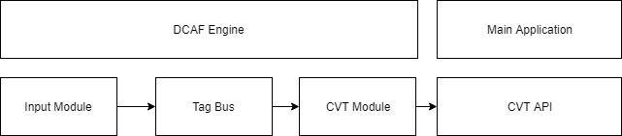
Coding outside DCAF - CVT

Slide 11
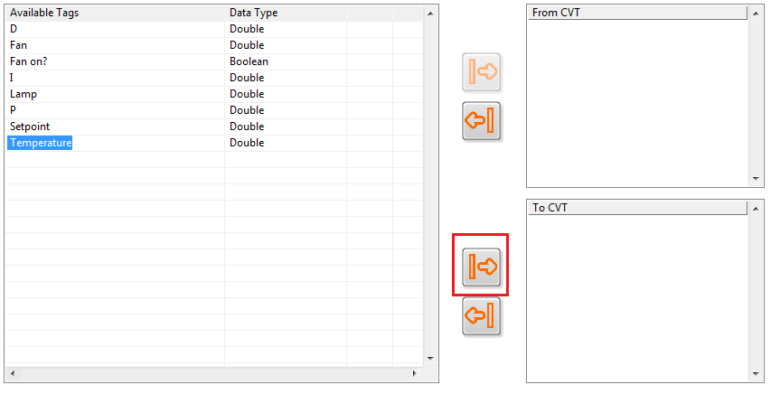
Coding outside DCAF - CVT
To get Tag Data out of DCAF into the same main application, use CVT
Pass the Tag to the CVT Module

Slide 12

Coding outside DCAF - CVT
Read the Tag with the CVT API
Use the Tag data in your application

Slide 13
Interacting with code Outside the Engine
http://www.ni.com/tutorial/53773/en/#
Shared Memory

Slide 14
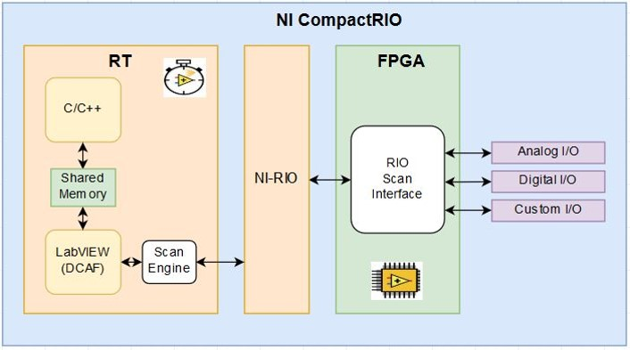
Shared Memory
DCAF can access Linux Shared Memory through a standard Module
Tags can then be accessed from LabVIEW or other languages

Slide 15
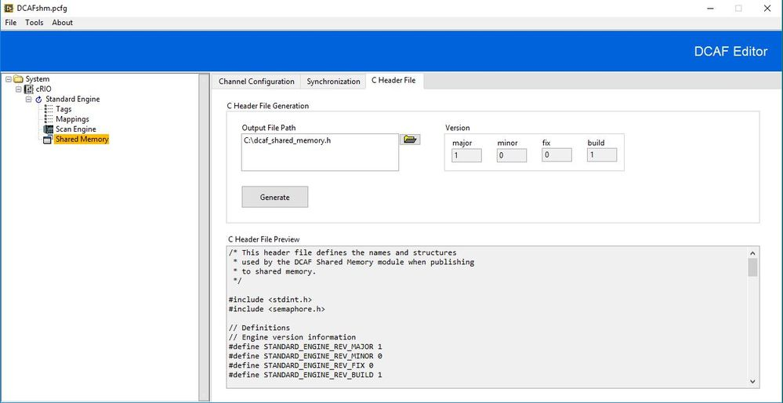
Shared Memory
Notes:
Application templates exist in addition to the plugin templates.

